Slide 1
SHIELDING
COMMUNICATIONS TOOLKIT
COMMUNICATIONS – OFFICIAL SENSITIVE

Slide 2
TABLE OF CONTENTS
Toolkit
Background and next steps
How you can support
Social media (social media pack incl. template graphics and images attached)
Departmental contact
Attached Annexes
Annex A: Shielding core narrative
Annex B: Clinical guidance and support offer explainer
Annex C: FAQs (for internal use only)
Annex D: Suggested social media copy
COMMUNICATIONS – OFFICIAL SENSITIVE

Slide 3
BACKGROUND
In March, DHSC published clinical advice for those most at risk from coronavirus, advising them to stay at home until the end of June. There are around 2.2 million people who fall into the clinically extremely vulnerable group in England.
To support those advised to shield, MHCLG announced a package of support for clinically extremely vulnerable people and has been working across Government and with the grocery industry, councils and local resilience forums to deliver this support. We remain committed to supporting this group as long as they are advised to shield.
From 1 June, guidance was relaxed in line with the latest evidence. This meant shielding individuals could choose to safely spend time outdoors with members of their immediate household, or, if they live alone, with one other person from another household.
COMMUNICATIONS – OFFICIAL SENSITIVE

Slide 4
NEXT STEPS
We have now reviewed the latest evidence and from 6 July those shielding will be able to spend time outdoors in a group of up to 6 people including those outside of their household, while maintaining social distancing.
Those who are shielding and live alone or are single parents with children will also be able to create a ‘support bubble’ with one other household of any size, following the same rules that are already in place for the wider population.
From 1 August, the shielding advice will relax further, allowing those shielding to do even more, such as visit shops and places of worship, provided they take particular care to maintain social distancing and minimise contact with others outside their household. Support will remain in place until end of July.
COMMUNICATIONS – OFFICIAL SENSITIVE

Slide 5
HOW YOU CAN SUPPORT
Guide people to the guidance and support available by:
Updating your website – consider hosting key shielding messages with links to GOV.UK guidance. Use Annex B for your web copy.
Using your social media channels to share key messages and the latest guidance– further details below.
Informing your networks with regular newsletters, updated training slides or call centre scripts, and direct communication to supporters and users.
Utilising case studies and practical examples – e.g. promote positive examples of people within your network who are shielding and adapting to the updated guidance.
Incorporate shielding key messages into media scripts and briefing for spokespeople – core narrative at Annex A.
Create messaging to encourage wider public to continue to follow social distancing to protect people who are clinically extremely vulnerable.
COMMUNICATIONS – OFFICIAL SENSITIVE

Slide 6
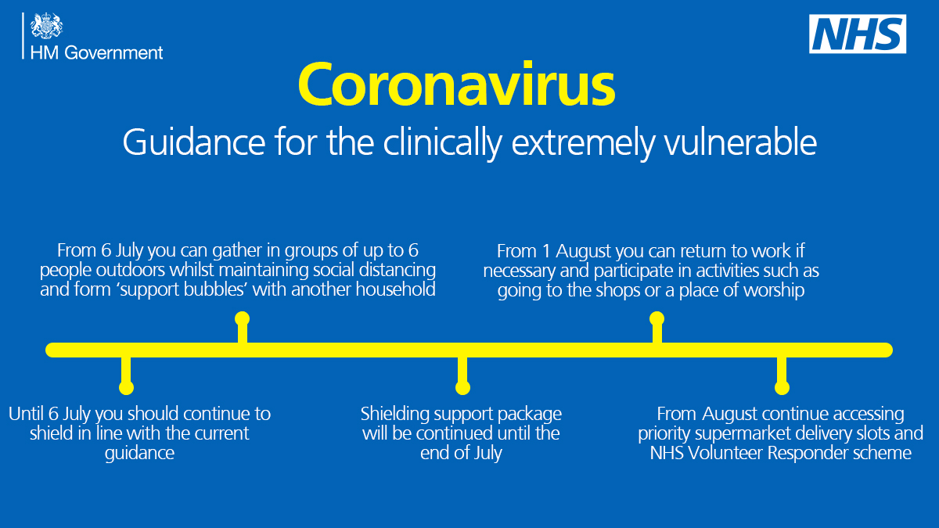
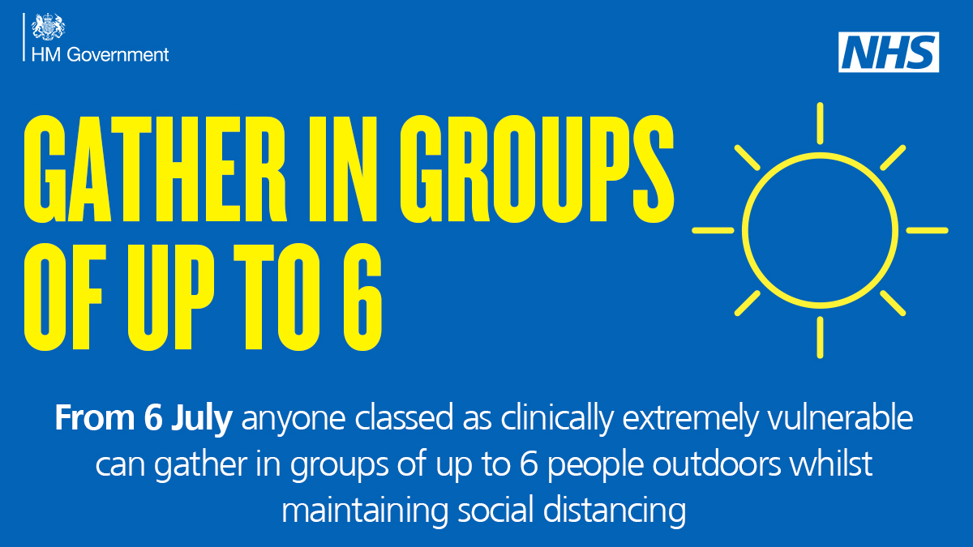
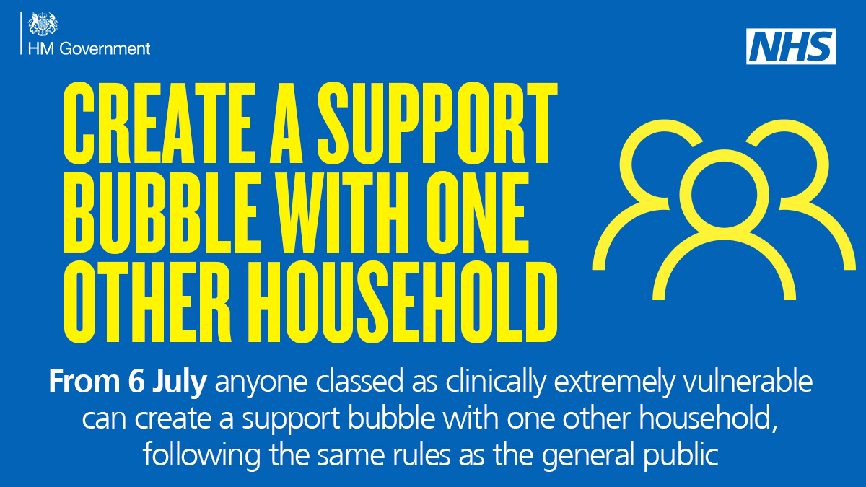
SOCIAL MEDIA PACK
In the attached social media pack, you will find a series of graphics and suggested tweets, and an animation explaining clinical guidance updates, reasons for the change in guidance and the support available for use on your channels.
Examples:
COMMUNICATIONS – OFFICIAL SENSITIVE

Slide 7
SOCIAL MEDIA POST GUIDELINES
Use your social media channels to share key messages:
Create your own content using the shielding narrative and include #Shielding in any posts. (Or use our suggested social media copy in Annex D).
Use animations, graphics and suggested tweets found in the attached social media pack.
Amplify government posts – follow @DSHCgovuk, @MHCLG and @NHSEngland for updates.
Update your website with key shielding messages and link to GOV.UK where advice is being kept up to date.
Use the following Twitter handles when tweeting about shielding – @MHCLG, @DHSCgovUK, @RobertJenrick, @MattHancock.
COMMUNICATIONS – OFFICIAL SENSITIVE

Slide 8
CONTACTS
Departmental contacts
MHCLG Local Government Engagement
Mark Singh, Local Engagement Team Leader – Shielding Directorate Mark.Singh@communities.gov.uk 07479 637836
MHCLG Communications
Philippa Silverman, Assistant Director – Shielding Communications Philippa.Silverman@communities.gov.uk 07458 113 185
DHSC External Affairs
Kelly North, External Affairs Officer Kelly.North@dhsc.gov.uk 07544 378108
COMMUNICATIONS – OFFICIAL SENSITIVE

